Slide 1
STOCK MARKET TRACKER

Slide 2
TEAM MEMBERS
DEVANSHI DADWAL (262)
DIKSHANT SOHAL (283)
DIPANKAR SETHI (287)
DIYANSHI GUPTA (305)

Slide 3
Problem statement: Stock Market Tracker: Create a stock market tracking app that fetches real-time stock data. Include a watchlist feature.
SOLUTION
We have created a GROWW CLONE (stock market tracker) using HTML, CSS, Javascript, API fetching.

Slide 4
INTRODUCTION
We have created a project Groww clone
(Stock Market Tracker)
A stock market tracking app that fetches real-time stock data. We have created this website using HTML,CSS, Javascript and API fetching.

Slide 5
FEATURES
Intuitive Design
Morden UI Components
Real Time data
CSS Animations
WEB Socket

Slide 6
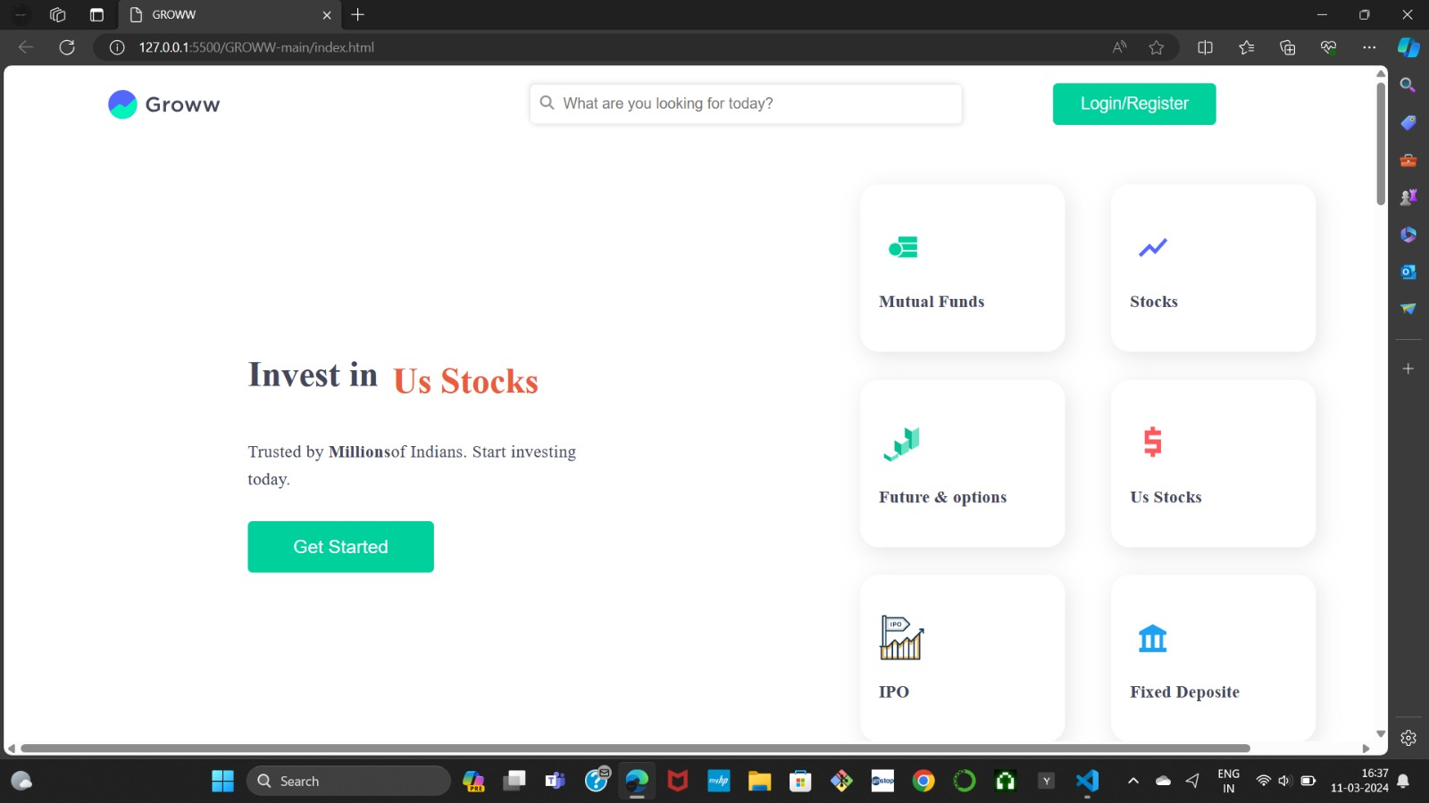
The is the main screen for Groww.

Slide 7
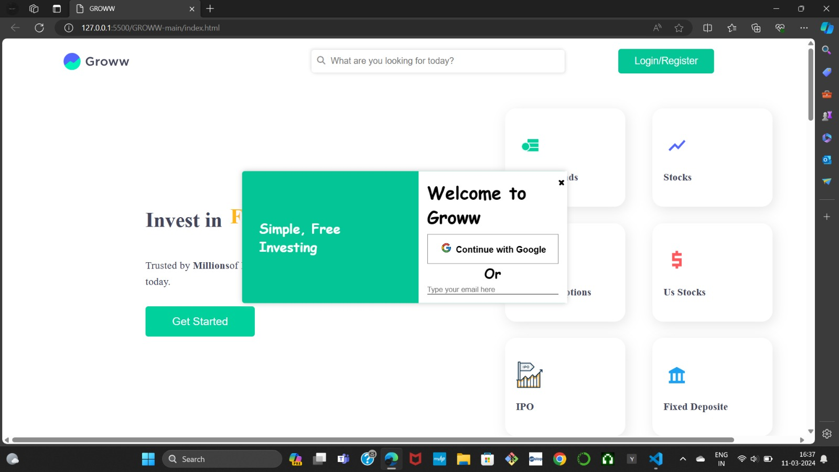
The login/register button triggers a pop up. The continue with Google locates the page to the main screen that displays stocks.

Slide 8
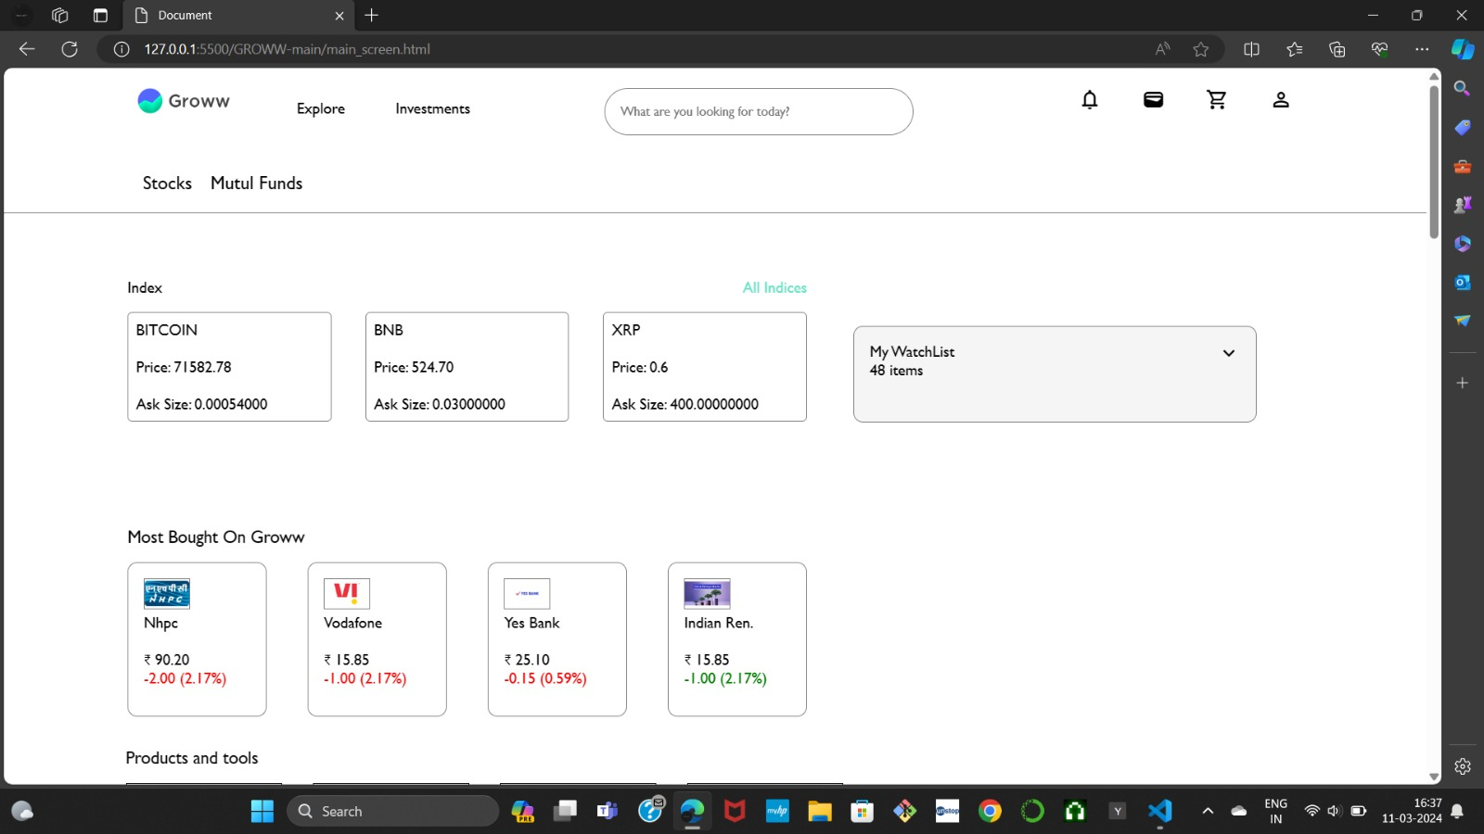
The main screen displays real time stock update using Websocket API.

